Slide 1
Heart disease Prediction
Team Name:- Predators
Team Number:- 4
Team Members:-
Prathamvir Singh Luthra 2210990677
Prabhjot Singh 2210990658
Raghav Baluni 2210990696
Prabal Rai 2210990657

Slide 2
Index
Objective
Introduction
Methodology & Techniques
Flow Chart
Source Code (screenshots)
Result
Conclusion
Reference

Slide 3
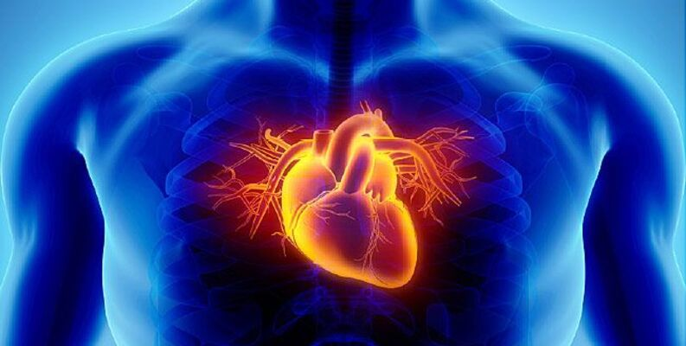
Objective
Early Detection: Identifying individuals at risk of developing heart disease before symptoms manifest allows for early intervention and prevention strategies, potentially averting serious complications.
Risk Stratification: Accurately assessing an individual's risk of developing heart disease enables healthcare professionals to tailor preventive measures and treatment plans according to the level of risk.
Preventive Medicine: By predicting heart disease risk factors, such as hypertension, high cholesterol, or diabetes, healthcare providers can intervene with lifestyle modifications (e.g., diet, exercise) and medication to mitigate risk and prevent the onset or progression of heart disease.
Resource Allocation: Predictive models can help healthcare systems allocate resources more efficiently by identifying high-risk individuals who may require more intensive monitoring or intervention.
Research and Development: Developing effective prediction models fosters ongoing research into the underlying causes and risk factors of heart disease, ultimately leading to improved prevention and treatment strategies.

Slide 4
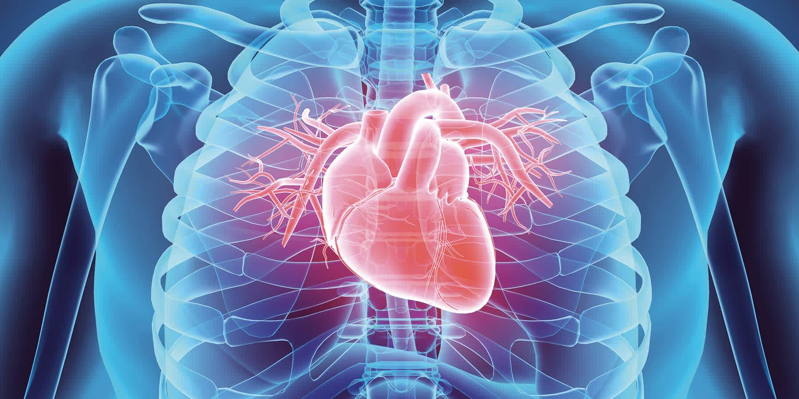
INTRODUCTION
Heart disease remains a significant global health concern, underscoring the urgency for effective preventive measures. Leveraging advanced machine learning techniques, this project aims to develop a predictive model for early detection of heart disease. By analyzing diverse patient data, including demographics, medical history, and lifestyle factors, we seek to create a robust tool for assessing individual risk profiles. Through rigorous validation and performance evaluation, our goal is to offer healthcare providers a valuable resource for proactive intervention and personalized care, ultimately mitigating the burden of heart disease on individuals and healthcare systems alike.

Slide 5
METHODOLOGY & Technique
Data Collection: Gather a comprehensive dataset containing relevant features such as age, sex, cholesterol levels, blood pressure, family history of heart disease, smoking status, and other medical conditions.
Data Preprocessing: Clean the dataset by handling missing values, encoding categorical variables, and normalizing numerical features to ensure consistency and reliability.
Exploratory Data Analysis (EDA): Explore the dataset to understand the distribution and relationships between variables. Visualize key features and identify potential patterns or correlations with heart disease incidence.
Model Selection: Choose appropriate machine learning algorithms for classification tasks, such as logistic regression, decision trees, random forests, or support vector machines.
Model Training: Split the dataset into training and validation sets. Train the selected models using the training data and optimize hyperparameters to improve performance.

Slide 6
Model Evaluation: Evaluate the trained models using metrics like accuracy, precision, recall, F1-score, and AUC-ROC on the validation set. Compare the performance of different models and select the best-performing one.
Validation and Testing: Validate the selected model using an independent test dataset to assess its generalization ability and robustness to unseen data.
Deployment: Deploy the trained model into a production environment, either as a standalone application or integrated within existing healthcare systems.
Monitoring and Maintenance: Implement monitoring mechanisms to track model performance over time. Regularly update the model using new data and retraining techniques to adapt to evolving patterns and improve predictive performance.

Slide 7
Flowchart
Data Collection
Data Preprocessing
Exploratory Data Analysis
Model Selection
Model Training
Monitoring and Maintenance
Deployment
Validation and Testing
Model Evaluation

Slide 8
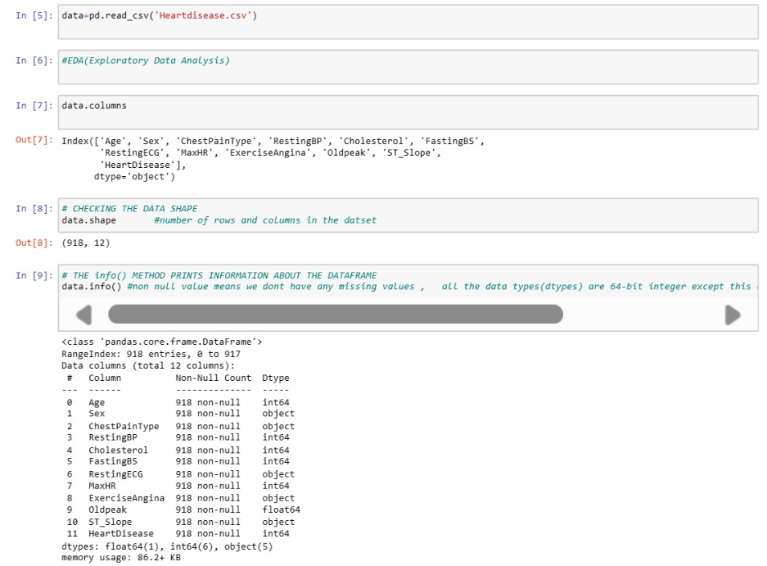
Source code

Slide 9
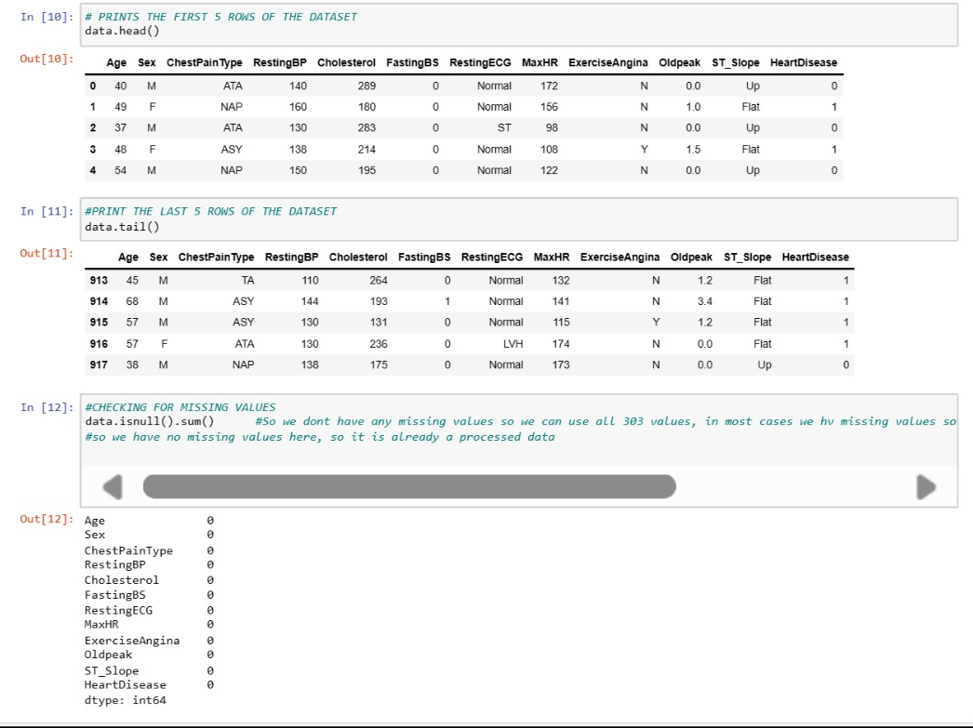

Slide 10
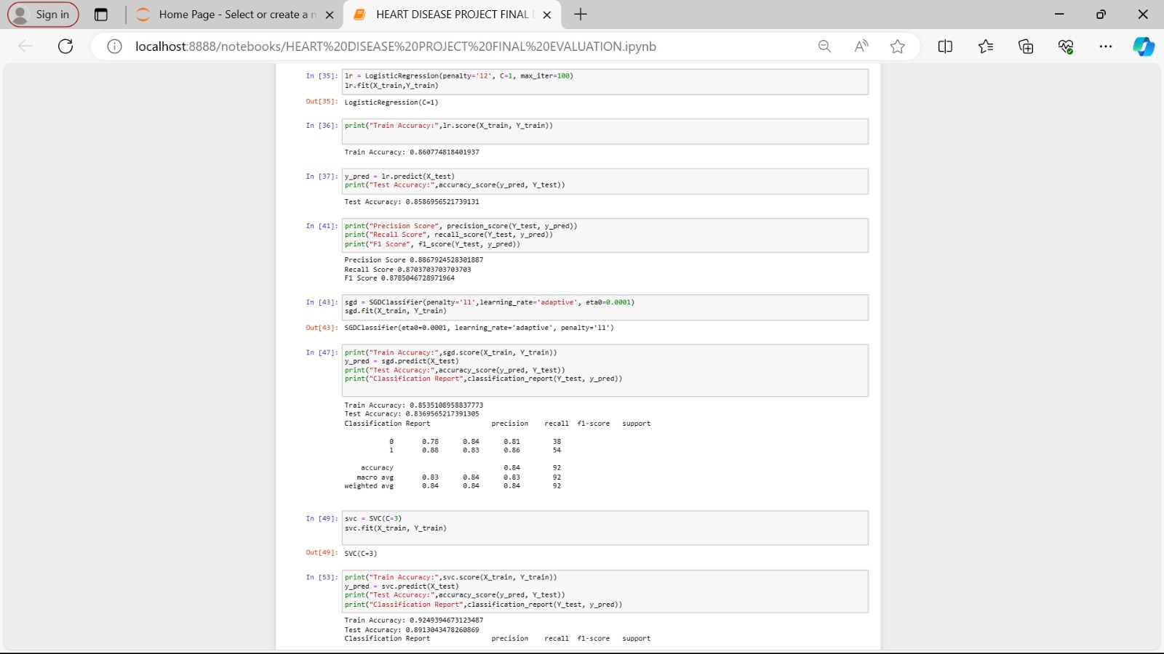

Slide 11
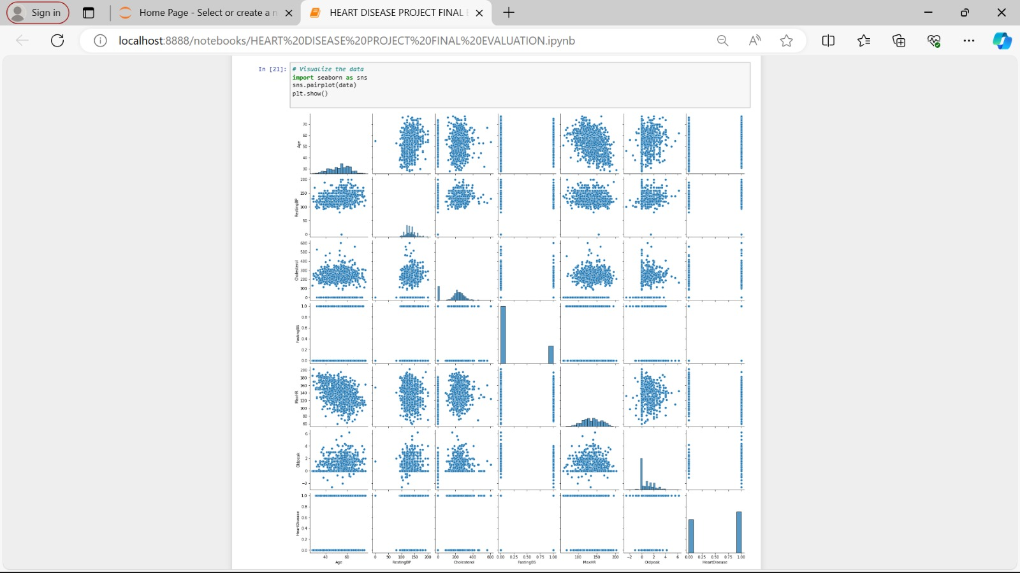

Slide 12
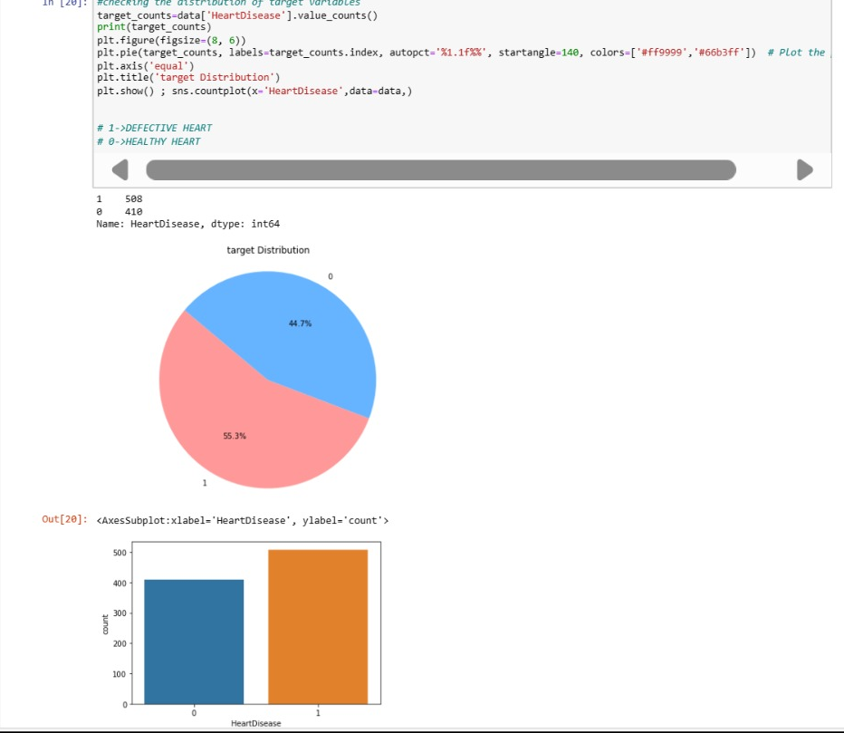

Slide 13
Result

Slide 14
Conclusion
In concluding the presentation on heart disease prediction using machine learning we have:
Impact and Significance: Emphasize the importance of accurate heart disease prediction for early intervention and prevention .
machine learning technique provide more timely, precise, and personalized predictions of disease risk.

Slide 15
Refrence
https://www.kaggle.com/datasets/fedesoriano/heart-failure-prediction

Slide 16
THE END

